Slide 1
International Union for Conservation of Nature & Natural Resources Grant Status Report - Period starting July 01, 2017-Sept. 30, 2017
FSM Development Bank Home Energy Loan Program

Slide 2
Annex 1- Work Plan (Services)
Activity Summary | Time Lines | Lead Agency | Collaborating Agency | Financial Implications (USD) |  |  |  | Comments
 |  |  |  | Quarter 1 | Quarter 2 | Quarter 3 | Quarter 4
Lisa Ranahan Andon New Construction 1st Model Home Wone, Kitti | April 2015- December 2015 | FSMDB | Contractor/clients |  | $6,000.00 |  |  | Construction Completed Subsidy of $6K issued April 2016 and applied to principal. Another $2K will be issued one year after. The final $2K will be issued on the 3rd year.
Gibroney Amor New Construction 2nd Model Home Awak,UH | April 2016 – February 2017 | FSMDB | Contractor/clients |  |  | $6,000.00 |  | Construction completed Subsidy of $6K issued February 2017 and applied to principal. Another $2K will be issued one year after. The final $2K will be issued on the 3rd year.
Swaiper Eliam Renovation & Remodeling Nanpohnmal, Sokehs | January 2016- May 2016 | FSMDB | Contractor/clients |  |  | $4,500.00 |  | Completed May 2016 – Subsidy of $4,500 issued on February 2017
Billy Obispo Renovation & Remodeling Awak, U | April 2016- December 2016 | FSMDB | Contractor/clients |  |  |  | $3,500.00 | Completed December 2016 – Subsidy of $3,500 issued on May 2017
Nefertti David New Construction Kitti | July 2016 – December 2016 | FSMDB | Contractor/Client | $0 |  |  |  | Completed June 2017 – Subsidy has not been issued
Jessica Nanpei New Construction Kolonia | September 2016 – January 2017 | FSMDB | Contractor/Client |  |  |  |  | Completed January 2017 – Subsidy has not been issued
SUB-TOTAL |  |  |  | $0 | $6K | 0 | $12,000

Slide 3
Activity Summary | Time Lines | Lead Agency | Collaborating Agency | Financial Implications (USD) |  |  |  | Comments
 |  |  |  | Quarter 1 | Quarter 2 | Quarter 3 | Quarter 4
Meltrise Paul New Construction Pehleng, Kitti | Approved March 2017 | FSMDB | Contractor/Clients |  |  |  | $6,000.00 | Awaiting Preconference
Mara Paul New Construction Pohnrakied | Approved May 2017 | FSMDB | Contractor/Clients |  |  |  | $6,000.00 | Awaiting Preconference
Augustine Ardos New Construction Seinwar, Kitti | September 2017 – February 2018 | FSMDB | Contractor/Clients |  |  |  | $6,000.00 | Construction ongoing ECD – February 2018
Josepha F.Etse New Construction Kahmar, Nett | August 2017-December 2017 | FSMDB | Contractor/Clients |  |  |  | $6,000.00 | Construction ongoing ECD – December 2017
K.S Vincent Sivas | June 2017 | FSMDB | Contractor/Clients |  |  |  | $6,000.00 | Awaiting Preconference
Mason Tihpen | February 2017 – June 2017 | FSMDB | Contractor/Clients |  |  | $6,000.00 |  | Completed June 2017 Subsidy has not been issued
Elly Amor | January 2017 – June 2017 | FSMDB | Contractor/Clients |  |  |  | $6,000.00 | Contract agreement was extended to November 2017

Slide 4
Work Plan Continued
Years | Subsidy Allocation | Renovation
Year 1 | $53K | $6K
Year 2 | $120K | $21k
Year 3 | $50K | -0-
Sub-total
Grand Total | $250K

Slide 5
Annex 2- Budget
Activity | Amount $ USD | Comment
New Home Construction | $120,000 | Estimated 20 homes in 2 years
Home Renovation | $105,000 | Estimated 40 homes in 2 years
Bank Retrofit for Efficiency | $18,000 | Changing of all existing lights to LED completed. Now Bank targeting to change all existing air conditioners to inverter type air condition units by end of year
Education Program | $0 | To be financed by Bank
Model Homes | $12,000 | Three homes estimated at $12K
Contingency | $5,000
Total | $260,000 | Total funding approved

Slide 6
Annex 3- Financial Statement- Breakdown of expenditures- July 01, 2016- Sept. 30, 2016
Budget | Actual | Variance
Grant Amount | $250,000 | $124,970 | $125,030
Activity
New Home Construction | 120,000 |  | 120,000
Home Renovations | 105,000 |  | 105,000
Bank Retrofit for Efficiency | 18,000 | 13,153.81 | 4,846.19
Model Homes | 12,000 | 6,000 | 6,000
Contingency | 5,000 |  | 5,000
Total | 260,000 | 19,153.81 | 240,846.19
Notes:
Take from chat

Slide 7
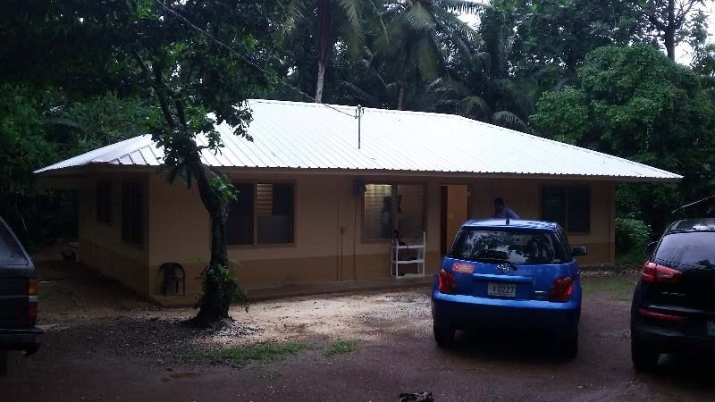
Ongoing Projects-FSMDB Home Energy Loan Program
Nefferti David- Kitti Municipality
Josepha F. Etse – Kahmar, Nett
Elly Amor – Awak, U
Jessica Nanpei- Kolonia Town
Mason Tihpen – Wapar Madolenihmw

